Slide 1
MAFS5130 Project
Group14 : Jiang Xiaoyue, Shen Ruilin, Jia Yaoyao

Slide 2
Content
Data Processing
Model Fitting & Forecast

Slide 3
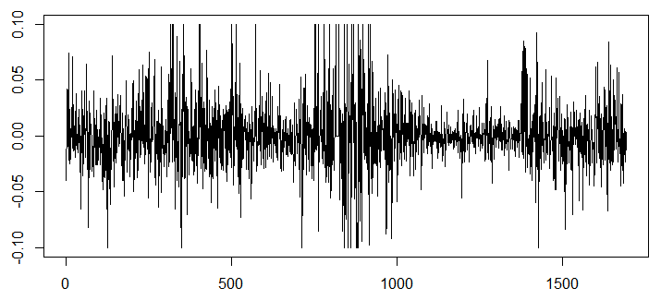
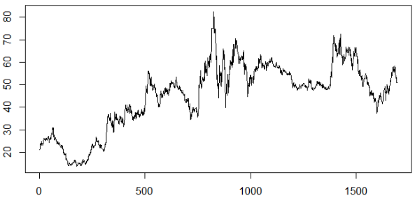
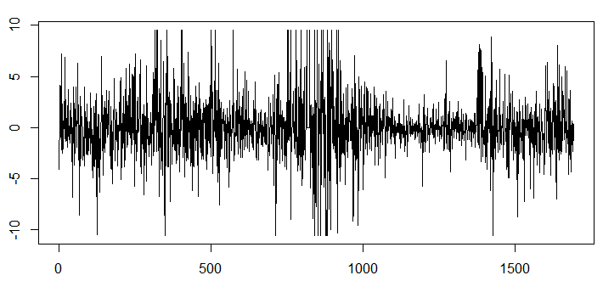
Data Processing
Dataset: daily frequency data of BYD stock from 2012 to 2018 year.
Containing: date, open price, return, log return.
The return of BYD
The open price of BYD
The percentage log return of BYD

Slide 4
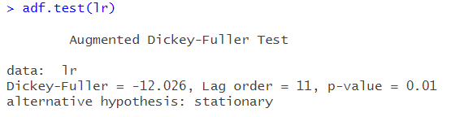
Data Processing
ADF test: to examine whether the dataset is stationary.
Conclusion: can not reject the null hypothesis that the time series is stationary.

Slide 5
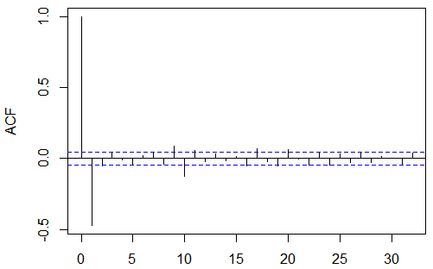
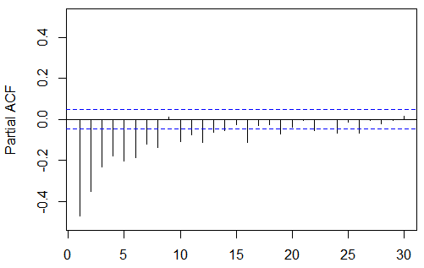
Data Processing
ACF and PCAF of percentage log return
Figure 5: ACF of percentage log-returns
Figure 6: PACF of percentage log-returns

Slide 6
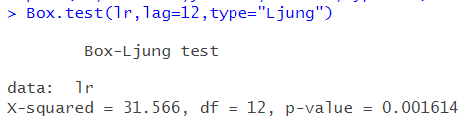
Data Processing
Box-Ljung test: to find the serial correlation.
Conclusion: there exists the series correlation in the dataset.

Slide 7
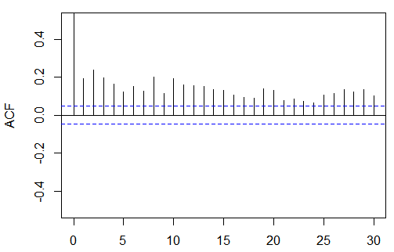
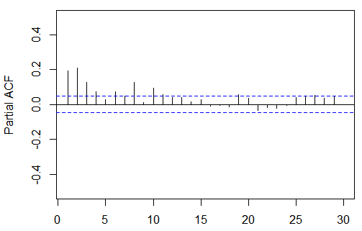
Data Processing
ACF and PCAF of log return square
Figure 5: ACF of log-return square
Figure 6: PACF of log-return square

Slide 8
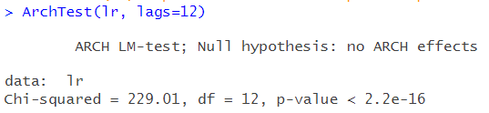
Data Processing
ArchTest: to find whether there is ARCH effect in the time series.
Conclusion: the series of log-returns have the ARCH effect, we may consider using GARCH models to fit the dataset.

Slide 9
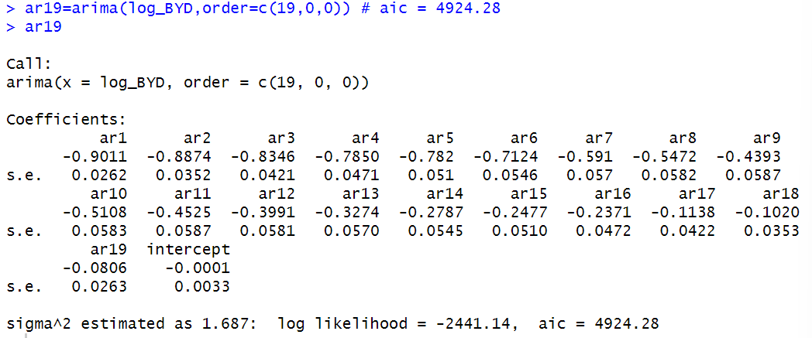
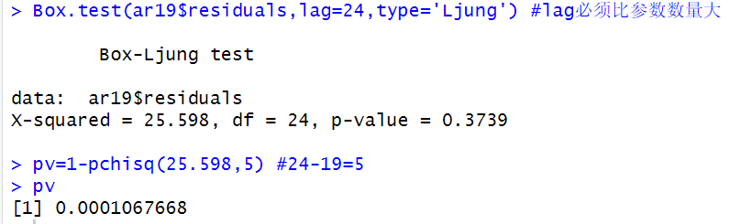
ARIMA Model
AR(p) Model
Inadequate!

Slide 10
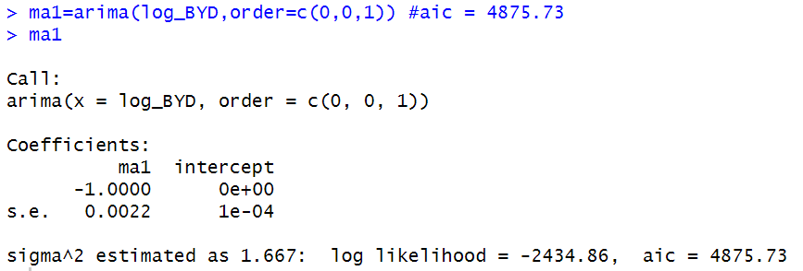
ARIMA Model
MA(q) Model
Inadequate!

Slide 11
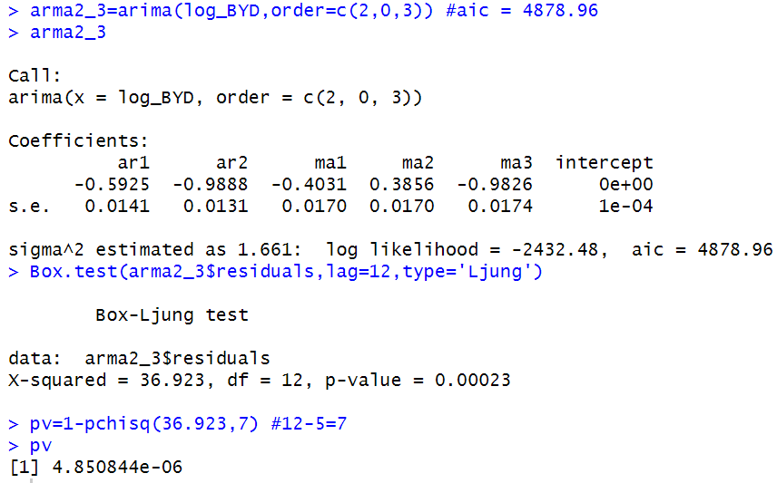
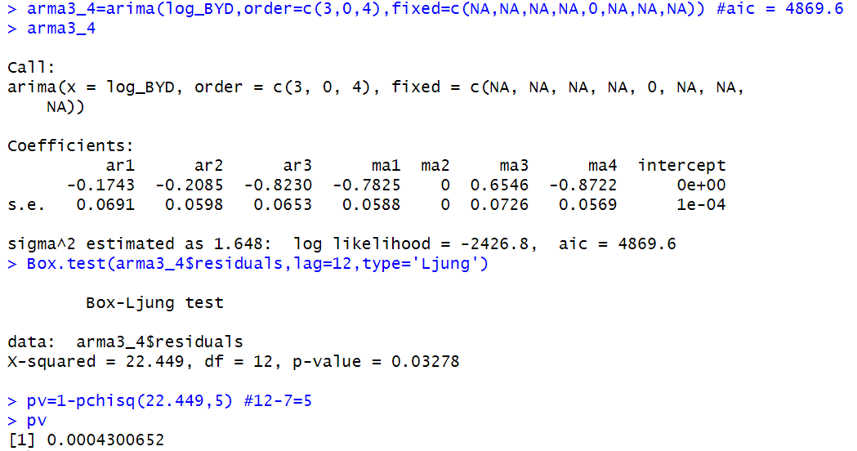
ARIMA Model
ARMA(p,q) Model
Inadequate!

Slide 12
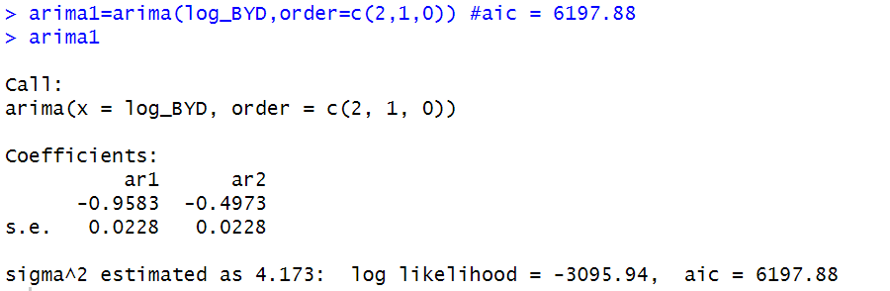
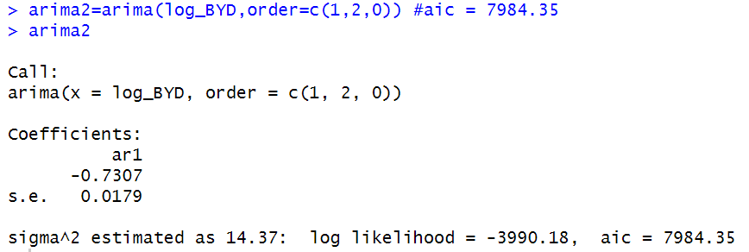
ARIMA Model
ARIMA(p,d,q) Model
Inadequate!

Slide 13
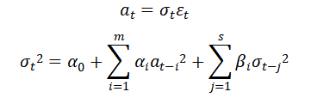
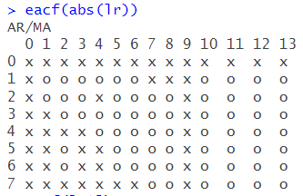
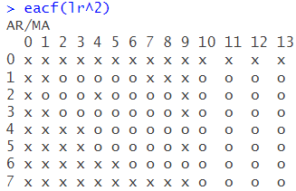
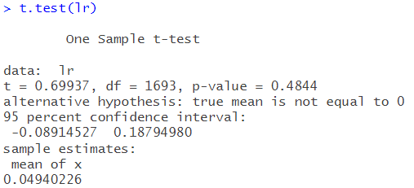
GARCH(m,s) Model
EACF
t-test

Slide 14
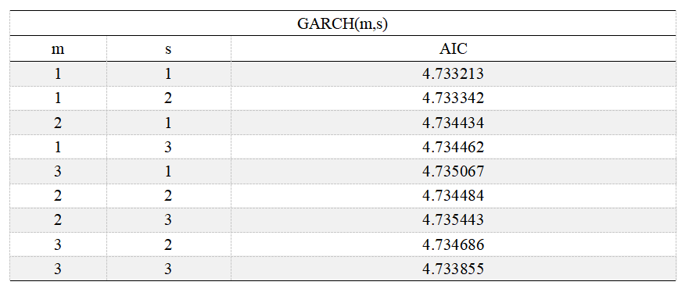
GARCH(m,s) Model
Different combinations of (m,s)
GARCH(1,1) model has the lowest AIC!

Slide 15
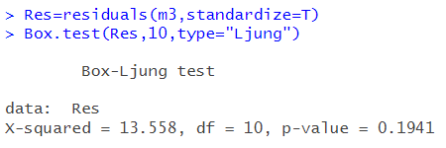
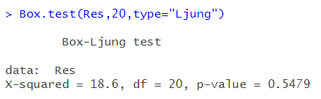
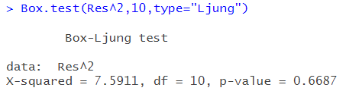
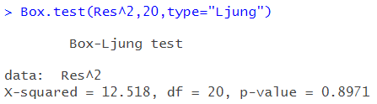
GARCH(m,s) Model
Residuals analysis of GARCH(1,1) model

Slide 16
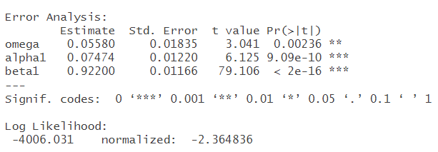

GARCH(m,s) Model
Parameters of GARCH(1,1) model

Slide 17
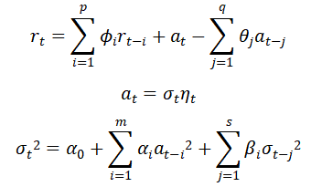
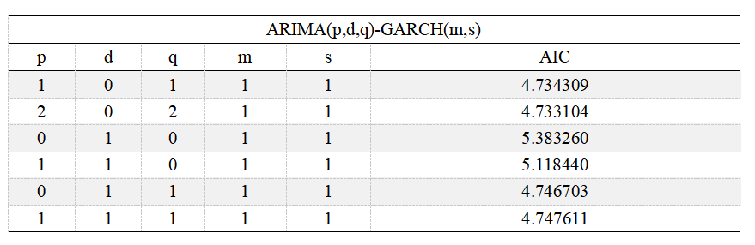
ARIMA(p,d,q)-GARCH(m,s) Model
Different combinations of (p,d,q)
ARMA(2,2)-GARCH(1,1) model has the lowest AIC!

Slide 18
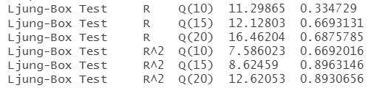

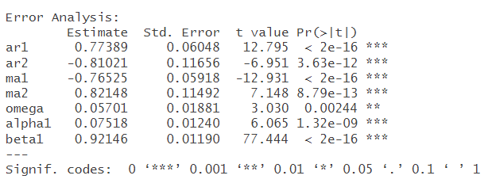
ARIMA(p,d,q)-GARCH(m,s) Model
Residuals analysis of ARMA(2,2)-GARCH(1,1) model
Parameters of ARMA(2,2)-GARCH(1,1) model

Slide 19
LSTM Model Setting
Model Structure:
LSTMModel(
(linear_1): Linear(in_features=1, out_features=32, bias=True)
(relu): ReLU()
(lstm): LSTM(32, 32, num_layers=2, batch_first=True)
(dropout): Dropout(p=0.2, inplace=False)
(linear_2): Linear(in_features=64, out_features=1, bias=True)
)
Model Setting:
Hyper parameter | Setting
Criterion | MSELoss
Optimizer | Adam
Dropout | 0.2
Learning Rate | 0.001
Epoch | 200
Sequence (window_size) | 3,5,10,15,20

Slide 20
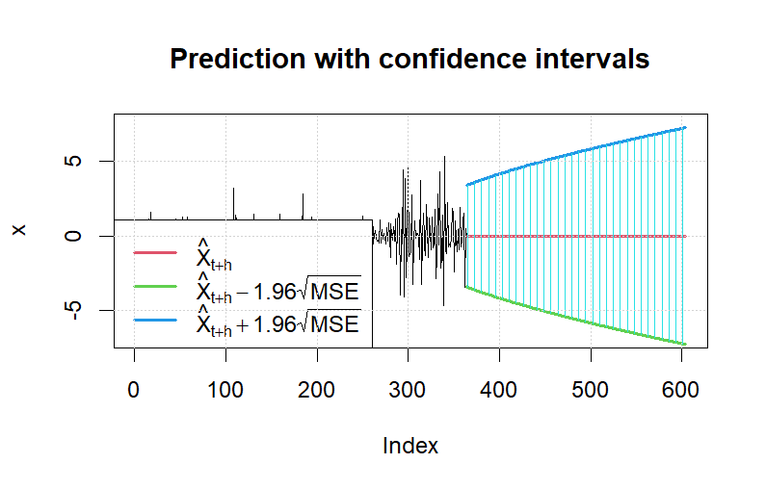
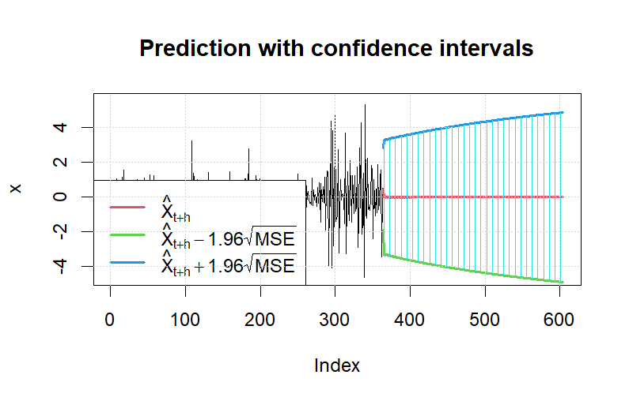
Forecast
ARMA(2,2)-GARCH(1,1) model forecast
GARCH(1,1) model forecast
ARMA(2,2)-GARCH(1,1) model has narrower confidence intervals in the long term.

Slide 21
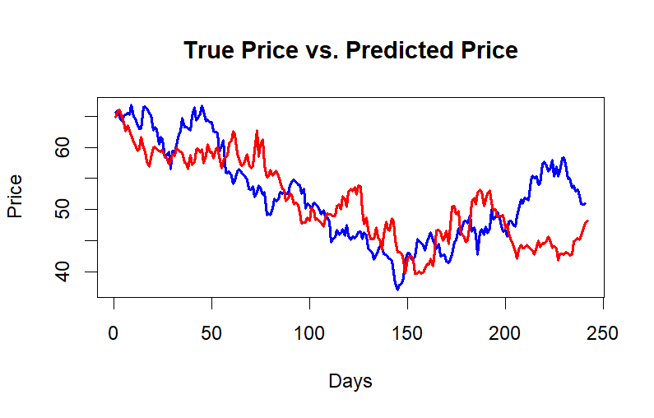
Forecast
GARCH(1,1) model forecast (use simulation to get the price)
Blue: true price
Red: predict price

Slide 22
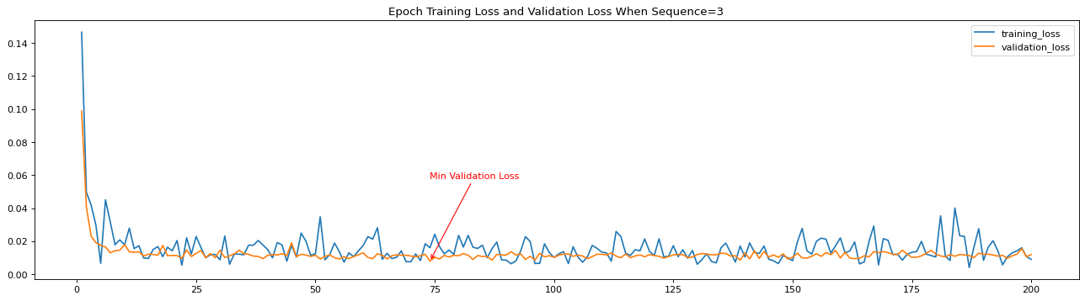
LSTM Model Training
Firstly use 2012-2016 data as train set, 2017 data as validation set, then use 2013-2017 data as train set, 2018 data as test set.
To avoid overfitting, we use dropout and find the epoch which has minimum validation loss during first train as optimal epoch_num.
Training & Validation Loss of Different Epoch
Minimum Validation Loss with Different Sequence
Sequence | Minimum Validation Loss
3 | 0.007991445
5 | 0.008481636
10 | 0.008229232
15 | 0.009599054
20 | 0.009699056

Slide 23
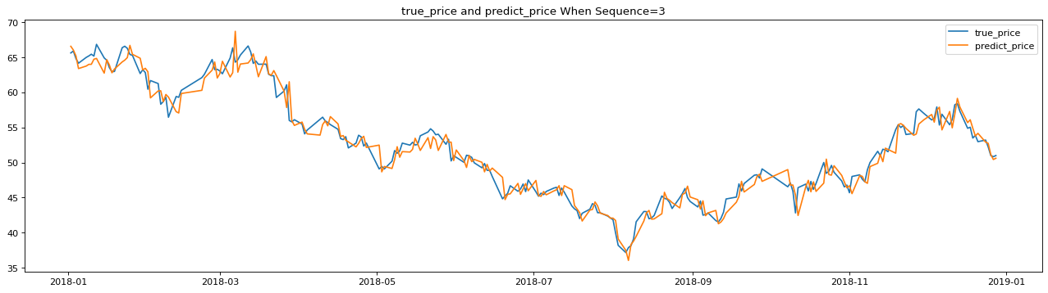
LSTM Forecast
We use the model with minimum validation Loss, that is the model with sequence=3.
Sequence | MSE | RMSE | MAE | R Square
3 | 1.983 | 1.408 | 1.082 | 0.9652
5 | 2.745 | 1.657 | 1.245 | 0.9519
10 | 2.057 | 1.434 | 1.087 | 0.9639
15 | 2.096 | 1.448 | 1.079 | 0.9633
20 | 2.177 | 1.476 | 1.141 | 0.9618
Comparison between real price and prediction
Comparison between different models

Slide 24
Thanks for Listening!

